Slide 1
Big Data Analytics and Mining
Junming Shao

Slide 2
Lecture 3
HASHING

Slide 3

Why we need HASHING?
Wal-Mart: 267 million items/day; 4PB data warehouse
Sloan Digital Sky Survey: New Mexico telescope captures 200 GB image data/day
Challenge in big data applications:
Curse of dimensionality
Storage cost
Query speed

Slide 4
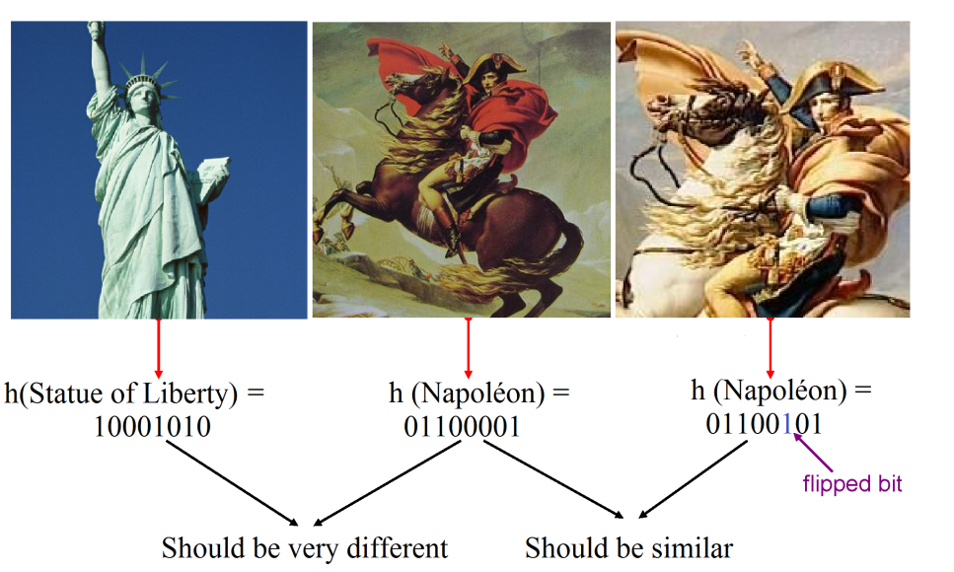
Example 1. Information Retrieval

Slide 5
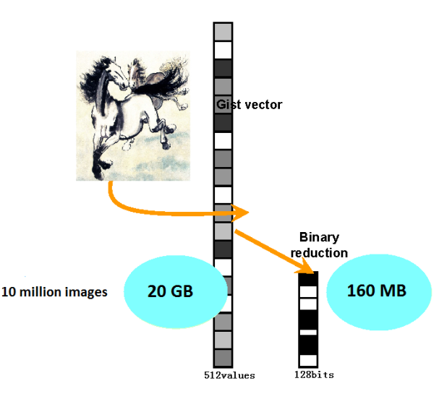
Example 2. Storage Cost

Slide 6
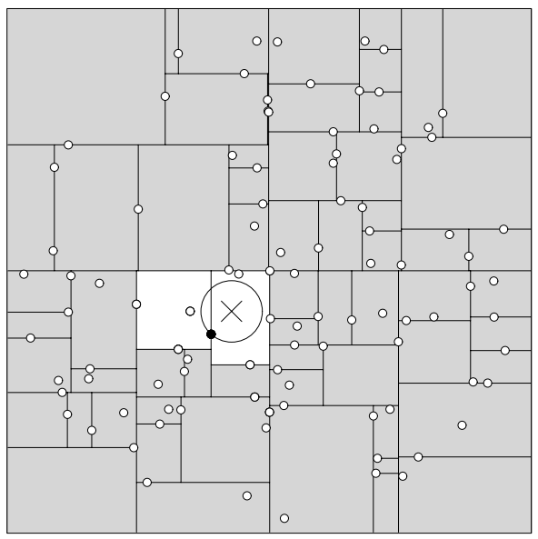
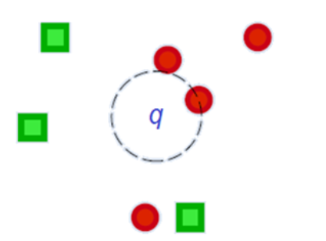
Example 3. Fast Nearest Neighbor Search
Given a query point q (high dimensional), return the points closest (similar) to q in the database.
KD-TREE
KD-tree cannot handle high-dimensional data.

Slide 7
WHAT WILL WE TALK?
Locality-Sensitive Hashing (Shingling+ MinHash)
Learning to Hash

Slide 8
Locality-Sensitive Hashing
Find Similar Items

Slide 9
Introduction
Introduction
Many Web-mining problems can be expressed as finding “similar” sets:
Pages with similar words, e.g., for classification by topic.
NetFlix users with similar tastes in movies, for recommendation systems.
Movies with similar sets of fans.
Images of related things.

Slide 10
CASE STUDY Finding Similar Documents

Slide 11
Introduction
Given a body of documents, e.g., the Web, find pairs of documents with a lot of text in common, e.g.:
Mirror sites, or approximate mirrors.
Application: Don’t want to show both in a search.
Plagiarism, including large quotations.
Similar news articles at many news sites.
Application: Cluster articles by “same story.”

Slide 12
Three Essential Techniques for Similar Documents
Introduction
Shingling : convert documents, emails, etc., to sets.
Minhashing : convert large sets to short signatures, while preserving similarity.
Locality-sensitive hashing : focus on pairs of signatures likely to be similar.

Slide 13
The Big Picture
Introduction
Candidate
pairs :
those pairs
of signatures
that we need
to test for
similarity.
Shingling
Minhash-
ing
Locality-
sensitive
Hashing
Document
The set
of strings
of length k
that appear
in the document
Signatures :
short integer
vectors that
represent the
sets, and
reflect their
similarity

Slide 14
Shingles
Shingling
A k -shingle (or k -gram) for a document is a sequence of k characters that appears in the document.
Example: k=2; doc = abcab. Set of 2-shingles = {ab, bc, ca}.
Option: regard shingles as a bag, and count ab twice.
Represent a doc by its set of k-shingles.

Slide 15
Assumption
Shingling
Documents that have lots of shingles in common have similar text, even if the text appears in different order.
Careful: you must pick k large enough, or most documents will have most shingles.
k = 5 is OK for short documents; k = 10 is better for long documents.

Slide 16
Min-Hashing

Slide 17
Basic Data Model: Sets
Minhashing
Preliminary
Many similarity problems can be couched as finding subsets of some universal set that have significant intersection.
Examples include:
Documents represented by their sets of shingles (or hashes of those shingles).
Similar customers or products.

Slide 18
Jaccard Similarity of Sets
Minhashing
The Jaccard similarity of two sets is the size of their intersection divided by the size of their union.
Sim (C₁, C₂) = |C₁∩C₂|/|C₁∪C₂|.
3 in intersection.
8 in union.
Jaccard similarity
= 3/8

Slide 19
From Sets to Boolean Matrices
Minhashing
Rows = elements of the universal set.
Columns = sets.
1 in row e and column S if and only if e is a member of S.
Column similarity is the Jaccard similarity of the sets of their rows with 1.
Typical matrix is sparse.

Slide 20
Example: Jaccard Similarity of Columns
Minhashing
C₁ C₂
0 1
1 0
1 1 Sim (C₁, C₂) = 2/5 = 0.4
0 0
1 1
0 1
*
*
*
*
*
*
*

Slide 21
When Is Similarity Interesting?
Minhashing
When the sets are so large or so many that they cannot fit in main memory.
Or, when there are so many sets that comparing all pairs of sets takes too much time.
Or both.

Slide 22
Outline of Min-Hashing
Minhashing
Compute signatures of columns = small summaries of columns.
Examine pairs of signatures to find similar signatures.
Essential: similarities of signatures and columns are related.
Optional: check that columns with similar signatures are really similar.

Slide 23
Signatures
Minhashing
Key idea: “hash” each column C to a small signature Sig (C), such that:
Sig (C) is small enough that we can fit a signature in main memory for each column.
Sim (C₁, C₂) is the same as the “similarity” of Sig (C₁) and Sig (C₂).

Slide 24
Four Types of Rows
Minhashing
Given columns C₁ and C₂, rows may be classified as:
C₁ C₂
a 1 1
b 1 0
c 0 1
d 0 0
Also, a = # rows of type a , etc.
Note: Sim (C₁, C₂) = a /(a +b +c ).

Slide 25
Signatures
Minhashing
Imagine the rows permuted randomly.
Define “hash” function h (C ) = the number of the first (in the permuted order) row in which column C has 1.
Use several (e.g., 100) independent hash functions to create a signature.

Slide 26
Example: Minhashing
6
7
1
0
1
1
0
3
6
2
0
0
1
1
3
1
1
2
1
5
3
1
0
0
0
2
2
1
3
7
4
4
0
1
0
1
2
3
5
0
0
0
1
1
5
3
2
5
2
6
1
1
0
0
4
1
7
0
0
1
0
Signature Matrix
Permutation
Input Matrix

Slide 27
Surprising Property
Minhashing
The probability (over all permutations of the rows) that h (C₁) = h (C₂) is the same as Sim (C₁, C₂).
Both are a /(a +b +c )!
Why?
Look down the permuted columns C₁ and C₂ until we see a 1.
If it’s a type-a row, then h (C₁) = h (C₂). If a type-b or type-c row, then not.

Slide 28
Minhash Signatures
Minhashing
Pick (say) 100 random permutations of the rows.
Think of Sig (C) as a column vector.
Let Sig (C)[i] =
according to the i th permutation, the number of the first row that has a 1 in column C.

Slide 29
Min Hashing – Example
0
1
1
0
Columns 1 & 2:
Jaccard similarity 1/4
Signature similarity 1/3
0
0
1
1
3
1
1
2
1
0
0
0
2
2
1
3
Columns 2 & 3:
Jaccard similarity 1/5
Signature similarity 1/3
0
1
0
1
0
0
0
1
1
5
3
2
1
1
0
0
Columns 3 & 4:
Jaccard similarity 1/5
Signature similarity 0
0
0
1
0
Signature Matrix
Input Matrix

Slide 30
Implementation – (1)
Minhashing
Suppose 1 billion rows.
Hard to pick a random permutation from 1…billion.
Representing a random permutation requires 1 billion entries.
Accessing rows in permuted order leads to thrashing.

Slide 31
Implementation – (2)
Minhashing
A good approximation to permuting rows: pick 100 (?) hash functions.
For each column c and each hash function h_{i} , keep a “slot” M (i, c ).
Intent: M (i, c ) will become the smallest value of h_{i} (r ) for which column c has 1 in row r.
I.e., h_{i} (r ) gives order of rows for i th permuation.

Slide 32
Implementation – (3)
Minhashing
Initialize M(i,c) to ∞ for all i and c
for each row r
for each column c
if c has 1 in row r
for each hash function h_{i} do
if h_{i} (r ) is a smaller value than M (i, c ) then
M (i, c ) := h_{i} (r );

Slide 33
Example
Minhashing
Sig1 Sig2
Row C1 C2
1 1 0
2 0 1
3 1 1
4 1 0
5 0 1
h(1) = 1 1 -
g(1) = 3 3 -
h(2) = 2 1 2
g(2) = 0 3 0
h(3) = 3 1 2
g(3) = 2 2 0
h(x) = x mod 5
g(x) = 2x+1 mod 5
h(4) = 4 1 2
g(4) = 4 2 0
h(5) = 0 1 0
g(5) = 1 2 0

Slide 34
Implementation – (4)
Minhashing
Often, data is given by column, not row.
E.g., columns = documents, rows = shingles.
If so, sort matrix once so it is by row.
And always compute h_{i} (r ) only once for each row.

Slide 35
Locality-Sensitive Hashing

Slide 36
Finding Similar Pairs
Locality-Sensitive Hashing
Suppose we have, in main memory, data representing a large number of objects.
May be the objects themselves .
May be signatures as in minhashing.
We want to compare each to each, finding those pairs that are sufficiently similar.

Slide 37
Checking All Pairs is Hard
Locality-Sensitive Hashing
While the signatures of all columns may fit in main memory, comparing the signatures of all pairs of columns is quadratic in the number of columns.
Example: 10⁶ columns implies 5*10¹¹ column-comparisons.
At 1 microsecond/comparison: 6 days.

Slide 38
Locality-Sensitive Hashing
Locality-Sensitive Hashing
General idea: Use a function f(x,y) that tells whether or not x and y is a candidate pair : a pair of elements whose similarity must be evaluated.
For minhash matrices: Hash columns to many buckets, and make elements of the same bucket candidate pairs.

Slide 39
Candidate Generation From Minhash Signatures
Locality-Sensitive Hashing
Pick a similarity threshold s, a fraction < 1.
A pair of columns c and d is a candidate pair if their signatures agree in at least fraction s of the rows.
I.e., M (i, c ) = M (i, d ) for at least fraction s values of i.

Slide 40
LSH for Minhash Signatures
Locality-Sensitive Hashing
Big idea: hash columns of signature matrix M several times.
Arrange that (only) similar columns are likely to hash to the same bucket.
Candidate pairs are those that hash at least once to the same bucket.
Trick: divide signature rows into bands.
Each hash function based on one band.

Slide 41
Partition Into Bands
Locality-Sensitive Hashing
r rows
per band
b bands
One
signature
Matrix M

Slide 42
Partition into Bands
Locality-Sensitive Hashing
Divide matrix M into b bands of r rows.
For each band, hash its portion of each column to a hash table with k buckets.
Make k as large as possible.
Candidate column pairs are those that hash to the same bucket for ≥ 1 band.
Tune b and r to catch most similar pairs, but few dissimilar pairs.

Slide 43
Locality-Sensitive Hashing
Columns 2 and 6
are probably identical.
Buckets
Columns 6 and 7 are
surely different.
Matrix M
r rows
b bands

Slide 44
Example: Effect of Bands
Locality-Sensitive Hashing
Suppose 100,000 columns.
Signatures of 100 integers.
Therefore, signatures take 40Mb.
Want all 80%-similar pairs.
5,000,000,000 pairs of signatures can take a while to compare.
Choose 20 bands of 5 integers/band.

Slide 45
Suppose C₁, C₂ are 80% Similar
Locality-Sensitive Hashing
Probability C₁, C₂ identical in one particular band: (0.8)⁵ = 0.328.
Probability C₁, C₂ are not similar in any of the 20 bands: (1-0.328)²⁰ = .00035 .
i.e., about 1/3000th of the 80%-similar column pairs are false negatives.

Slide 46
Suppose C₁, C₂ Only 30% Similar
Locality-Sensitive Hashing
Probability C₁, C₂ identical in any one particular band: (0.3)⁵ = 0.00243 .
Probability C₁, C₂ identical in ≥ 1 of 20 bands: ≤ 20 * 0.00243 = 0.0486 .
In other words, approximately 4.86% pairs of docs with similarity 30% end up becoming candidate pairs
False positives

Slide 47
LSH Involves a Tradeoff
Locality-Sensitive Hashing
Pick the number of minhashes, the number of bands, and the number of rows per band to balance false positives/negatives.
Example: if we had only 15 bands of 5 rows, the number of false positives would go down, but the number of false negatives would go up.

Slide 48
What b Bands of r Rows Gives You
Locality-Sensitive Hashing
At least
one band
identical
No bands
identical
(
s ^{r}
t ~ (1/b)^{1/r}
1 -
1 -
)^{b}
Probability
of sharing
a bucket
Some row
of a band
unequal
All rows
of a band
are equal
t
Similarity s of two sets

Slide 49
Example: b = 20; r = 5
Locality-Sensitive Hashing
s | 1-(1-s^{r})^{b}
.2 | .006
.3 | .047
.4 | .186
.5 | .470
.6 | .802
.7 | .975
.8 | .9996

Slide 50
Learn to Hash

Slide 51
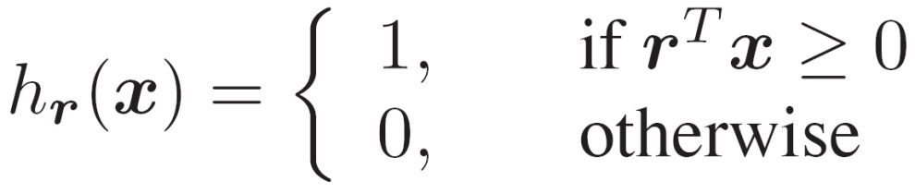



LSH function
The hashing function of LSH to produce Hash Code
is a hyperplane separating the space (next page for example)

Slide 52
Could we improve LSH?
Assume we have already learned a distance metric A from domain knowledge.
X^{T}AX has better quantity than simple metrics such as Euclidean distance.
No learning involved

Slide 53
Learn to Hash
Take random projections of data
Quantize each projection with few bits
0
101
Feature vector
1
0
1
1
0

Slide 54
Data-Dependent Methods
Hash functions are learned from a given training dataset. Compared with data-independent methods, data-dependent methods (also called learning to hash methods) can achieve comparable or even better accuracy with shorter binary codes.
Unsupervised Hashing
Supervised Hashing

Slide 55
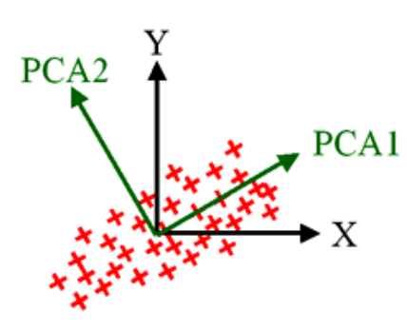
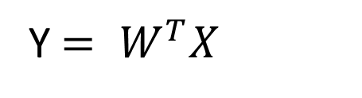
PCA Hashing
1.Projection Stage:
Get Transform matrix W, we can project x on new feature space.
Y$= W^{T}X$

Slide 56

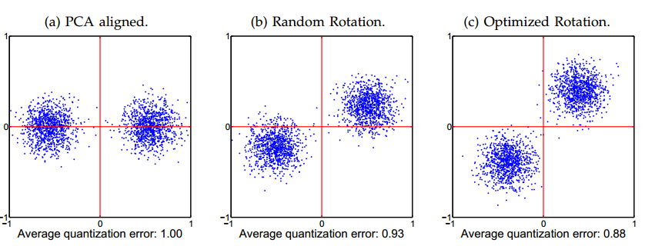
2.Quantization Stage
The strategy is too simple, The biggest problem is that assigning same bits to directions along which the data has a greater range.

Slide 57


PCA Hashing
Minimize the quantization loss:
$$Q\left(B,Y\right)=||B−Y^{T}R||_{F}^{2}$$
R is orthogonal matrix
$B=Sgn(Y^{T}R)$
The basic idea is rotating the data to minimize quantization loss.
Solution: Beginning with the random initialization of R, and adopt a k-means-like procedure. In each iteration, each data point is first assigned to the nearest vertex of the binary hypercube, and then R is updated to minimize the quantization loss given this assignment.
Yu et al. Large Scale Medical Image Search via Unsupervised PCA Hashing
Notes:
HASH 和降维的差别

Slide 58
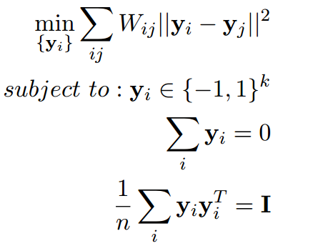
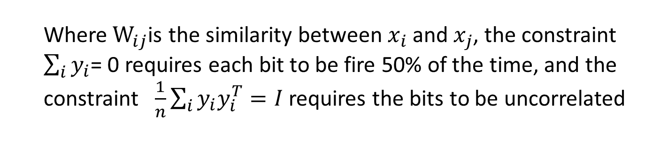
Spectral Hashing
Where${ W}_{ij}$is the similarity between$x_{i}$and $x_{j}$, the constraint $\sum_{i}{y_{i}}$= 0 requires each bit to be fire 50% of the time, and the constraint $\frac{1}{n}\sum_{i}{y_{i}y_{i}^{T}=I}$requires the bits to be uncorrelated

Slide 59
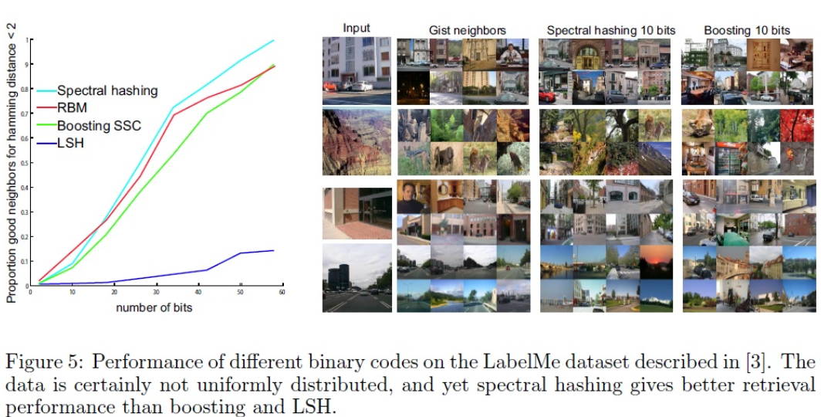
Spectral Hashing

Slide 60
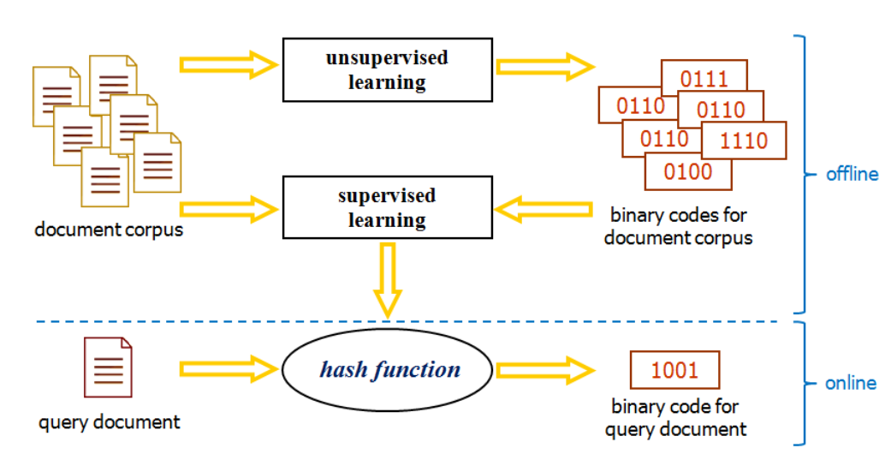
General Approach to Learning-Based Hashing
Decomposing the hashing learning problem into two steps:
hash bit learning
and hash function learning based on the learned bits.

Slide 61
Acknowledgement
Partial Slides are from
Prof. Jeffrey D. Ullman
Dr. Anand Rajaraman
Dr. Jure Leskovec

Slide 62
Take Home Message
MinHash
Local Sensitive Hash
Learn to Hash

Slide 63
Thanks !!!

